Slide 1
Data Wrangling

Slide 2
Resources
R for Data Science
R Studio Cheatsheets

Slide 3
Data wrangling steps - Tidyverse
Data import (readr, *readxl)
Data tidying (tidyr)
Data transformation (dplyr)
Helper packages: *lubridate (dates), forcats (factors), stringr (strings/characters)
* indicates not loaded with library(tidyverse)

Slide 4
Data wrangling
Reproducibility is key (therefore do it in a script)
Always check wrangled data against raw data to make sure things ran as you expected
Order of wrangling:
Fix column names
Tidy (Re-shape) dataframe (wide, long)
Fix cells (levels, spaces, case etc.)

Slide 5
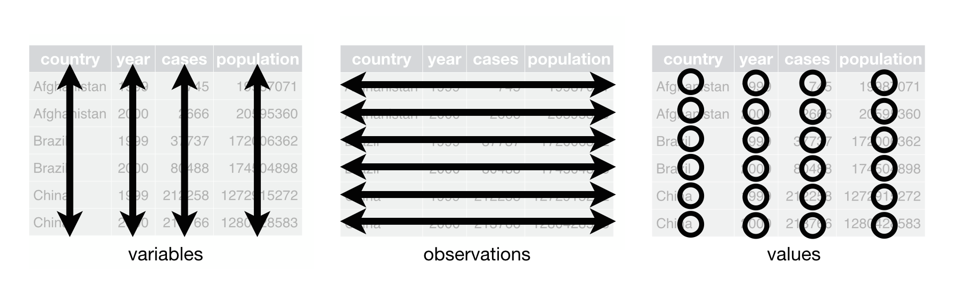
Tidy Data
Columns are variables and rows are observations.
Each type of observational unit is a table.

Slide 6
Common problems
Column headers are values, not variable names.
Multiple variables are stored in one column.
Variables are stored in both rows and columns.
Multiple types of observational units are stored in the same table.
A single observational unit is stored in multiple tables.

Slide 7
A tibble: 12 x 4
country year type count
<chr> <int> <chr> <int>
1 Afghanistan 1999 cases 745
2 Afghanistan 1999 population 19987071
3 Afghanistan 2000 cases 2666
4 Afghanistan 2000 population 20595360
5 Brazil 1999 cases 37737
6 Brazil 1999 population 172006362
7 Brazil 2000 cases 80488
8 Brazil 2000 population 174504898
9 China 1999 cases 212258
10 China 1999 population 1272915272
11 China 2000 cases 213766
12 China 2000 population 1280428583
# A tibble: 6 x 4
country year cases population
<chr> <int> <int> <int>
1 Afghanistan 1999 745 19987071
2 Afghanistan 2000 2666 20595360
3 Brazil 1999 37737 172006362
4 Brazil 2000 80488 174504898
5 China 1999 212258 1272915272
6 China 2000 213766 1280428583
# A tibble: 6 x 3
country year rate
* <chr> <int> <chr>
1 Afghanistan 1999 745/19987071
2 Afghanistan 2000 2666/20595360
3 Brazil 1999 37737/172006362
4 Brazil 2000 80488/174504898
5 China 1999 212258/1272915272
6 China 2000 213766/1280428583
# A tibble: 3 x 3
country `1999` `2000`
* <chr> <int> <int>
1 Afghanistan 745 2666
2 Brazil 37737 80488
3 China 212258 213766
Only one of these is tidy. Which one and why?
Notes:
Only table 1 is tidy. Why?

Slide 8
Piping
%>% symbol
Part of tidyverse
Replaces order of operations-style coding
#Here are four reasons why you should be using pipes in R:
You'll structure the sequence of your data operations from left to right, as apposed to from inside and out;
You'll avoid nested function calls;
You'll minimize the need for local variables and function definitions;
You'll make it easy to add steps anywhere in the sequence of operations.

Slide 9
Reshape dataframe
2 columns into 1: unite()
1 column into 2: separate()
Long to wide: Pivot_wider()
Wide to long: Pivot_long()
Fill in missing values: complete(), fill()
Combine tables:
bind_cols(), bind_rows()
___ join() lots of options of types of joins

Slide 10
Pivot_wider
From data carpentry

Slide 11
Pivot_longer
From data carpentry

Slide 12
Joins

Slide 13
Select: extract specific columns by name or position
Mutate: create new variables based on existing variables
Factor1 | Factor2 | Factor3 | Response1 | Response2 | Cov1 | Notes | NewCol
A
B
C
A
B
C
Filter: Subset observations by their values
Arrange: Rearrange order of rows
Summarize: calculate summary data from dataset and make new table (smaller)
Group_by: helper function, allows you to break dataset into groups and perform operations on them separately.

